Slide 1
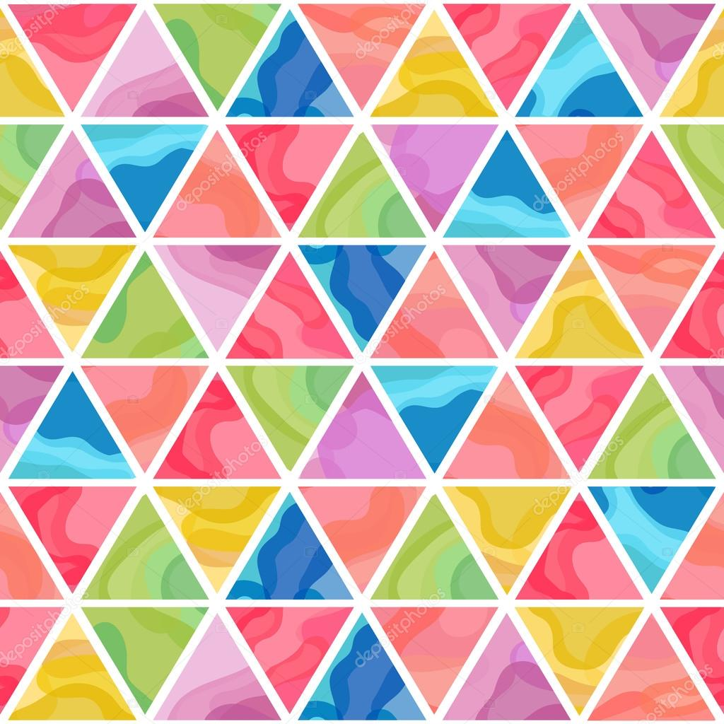
Patrones Hermosos

Slide 2
Let’s play an “encoding” game

Slide 3
Does anyone want to guess how I did it?
Discuss among your groups
If anyone thinks they figured it out and wants to try, raise your hand!

Slide 4

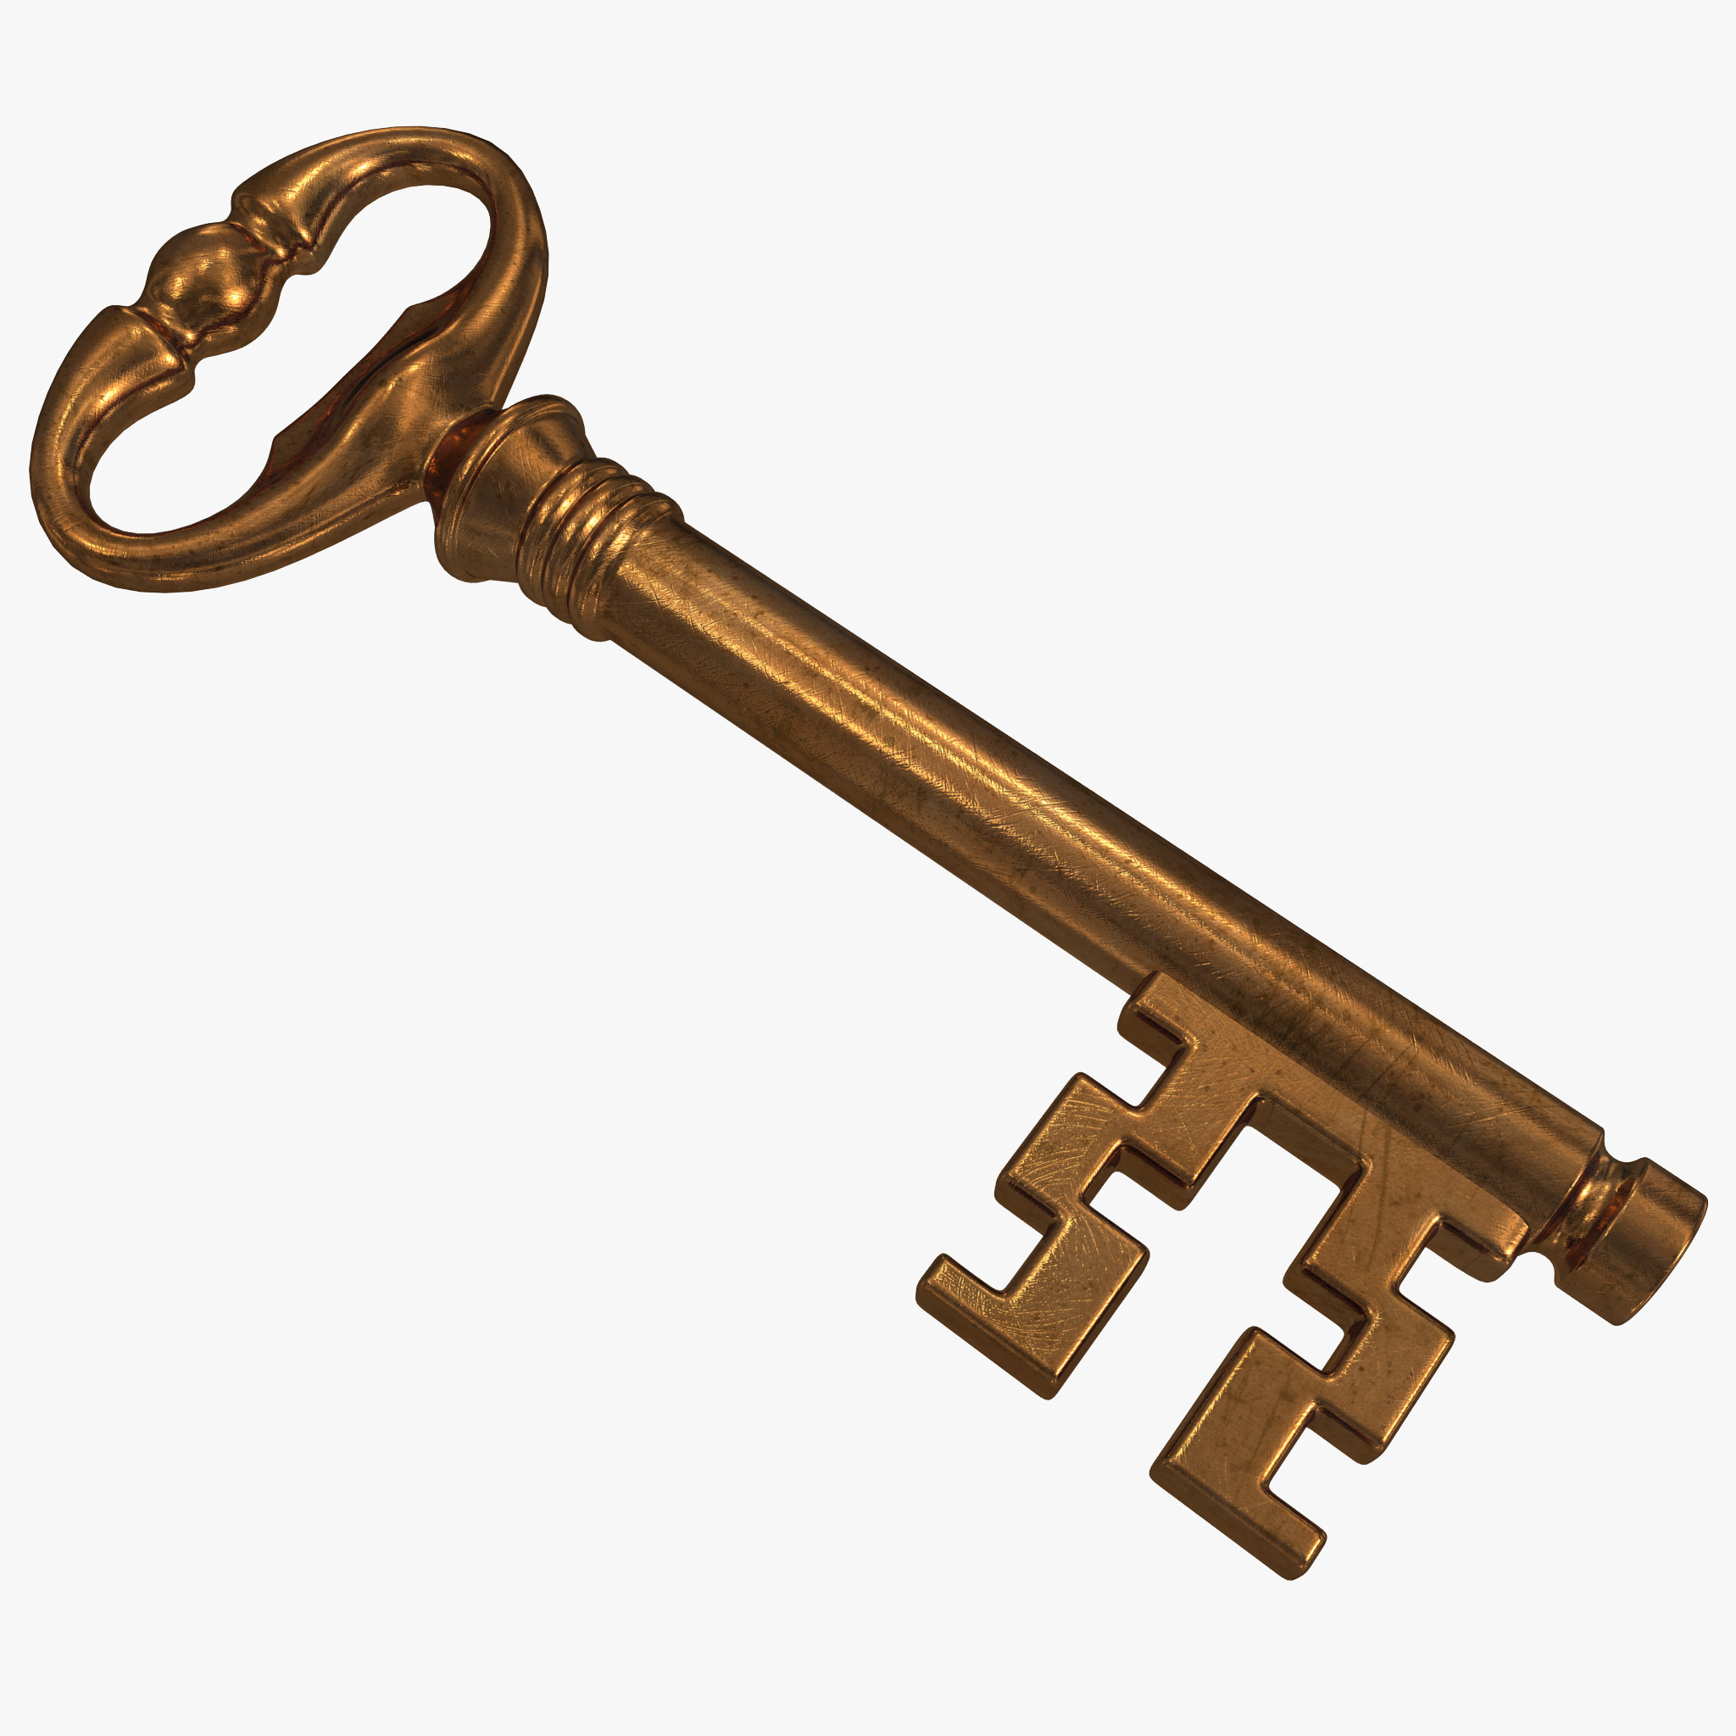
Cryptography
Alphabet
Rotation
Rail fence

Slide 5
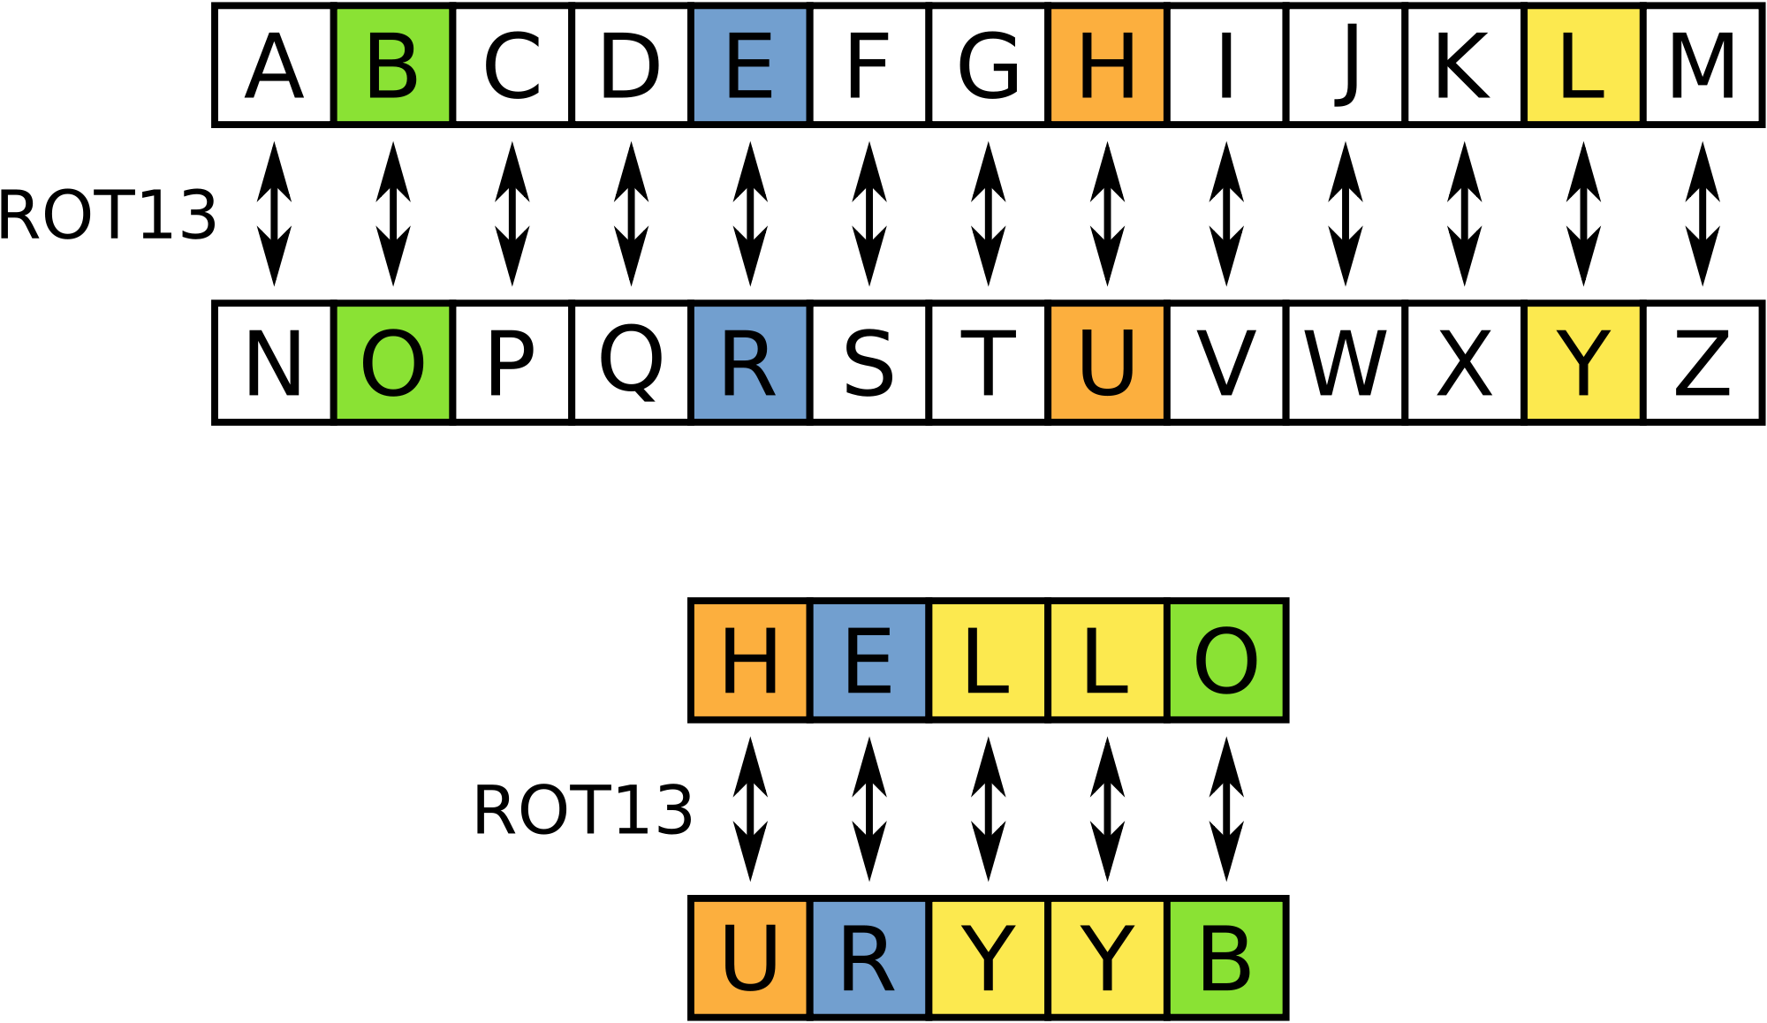
Rotational Cipher

Slide 6
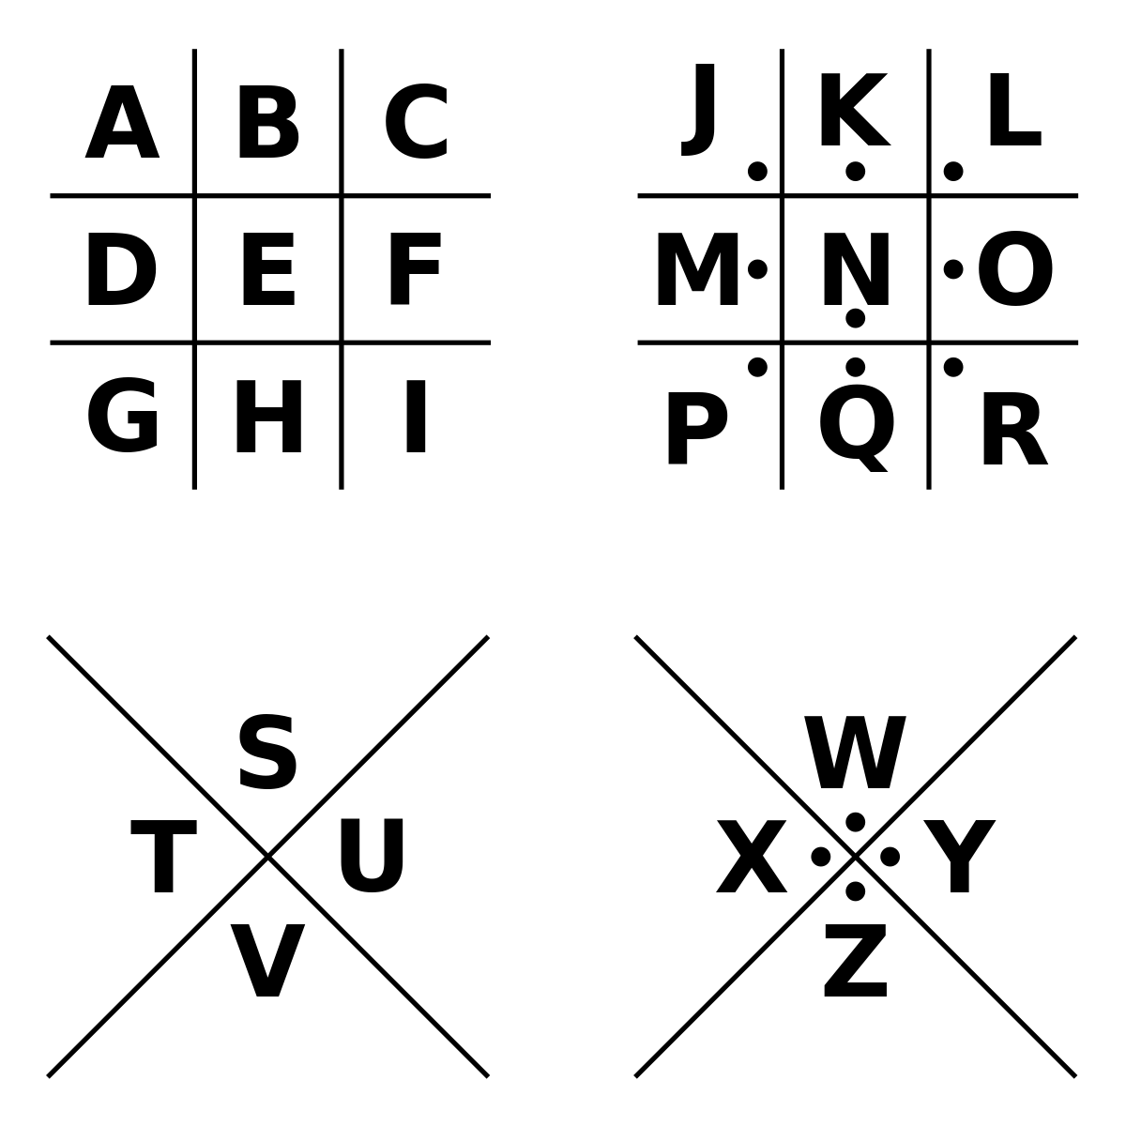
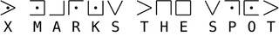
Pigeon Cipher

Slide 7
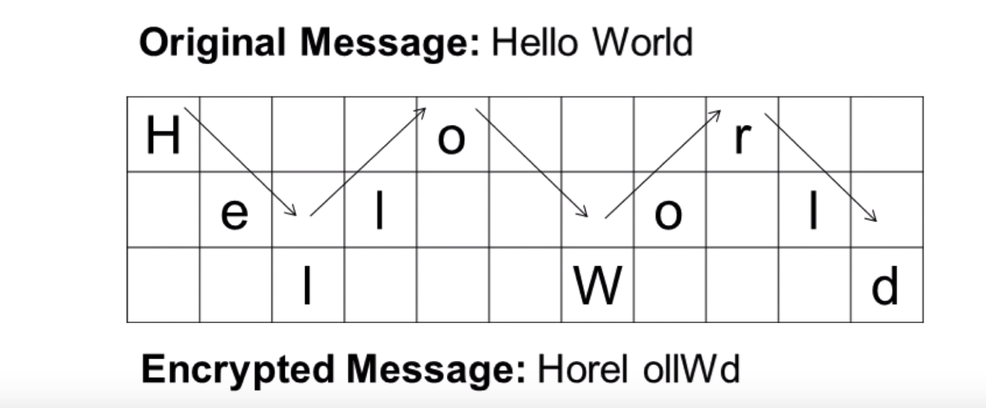
Pigeon Cipher

Slide 8
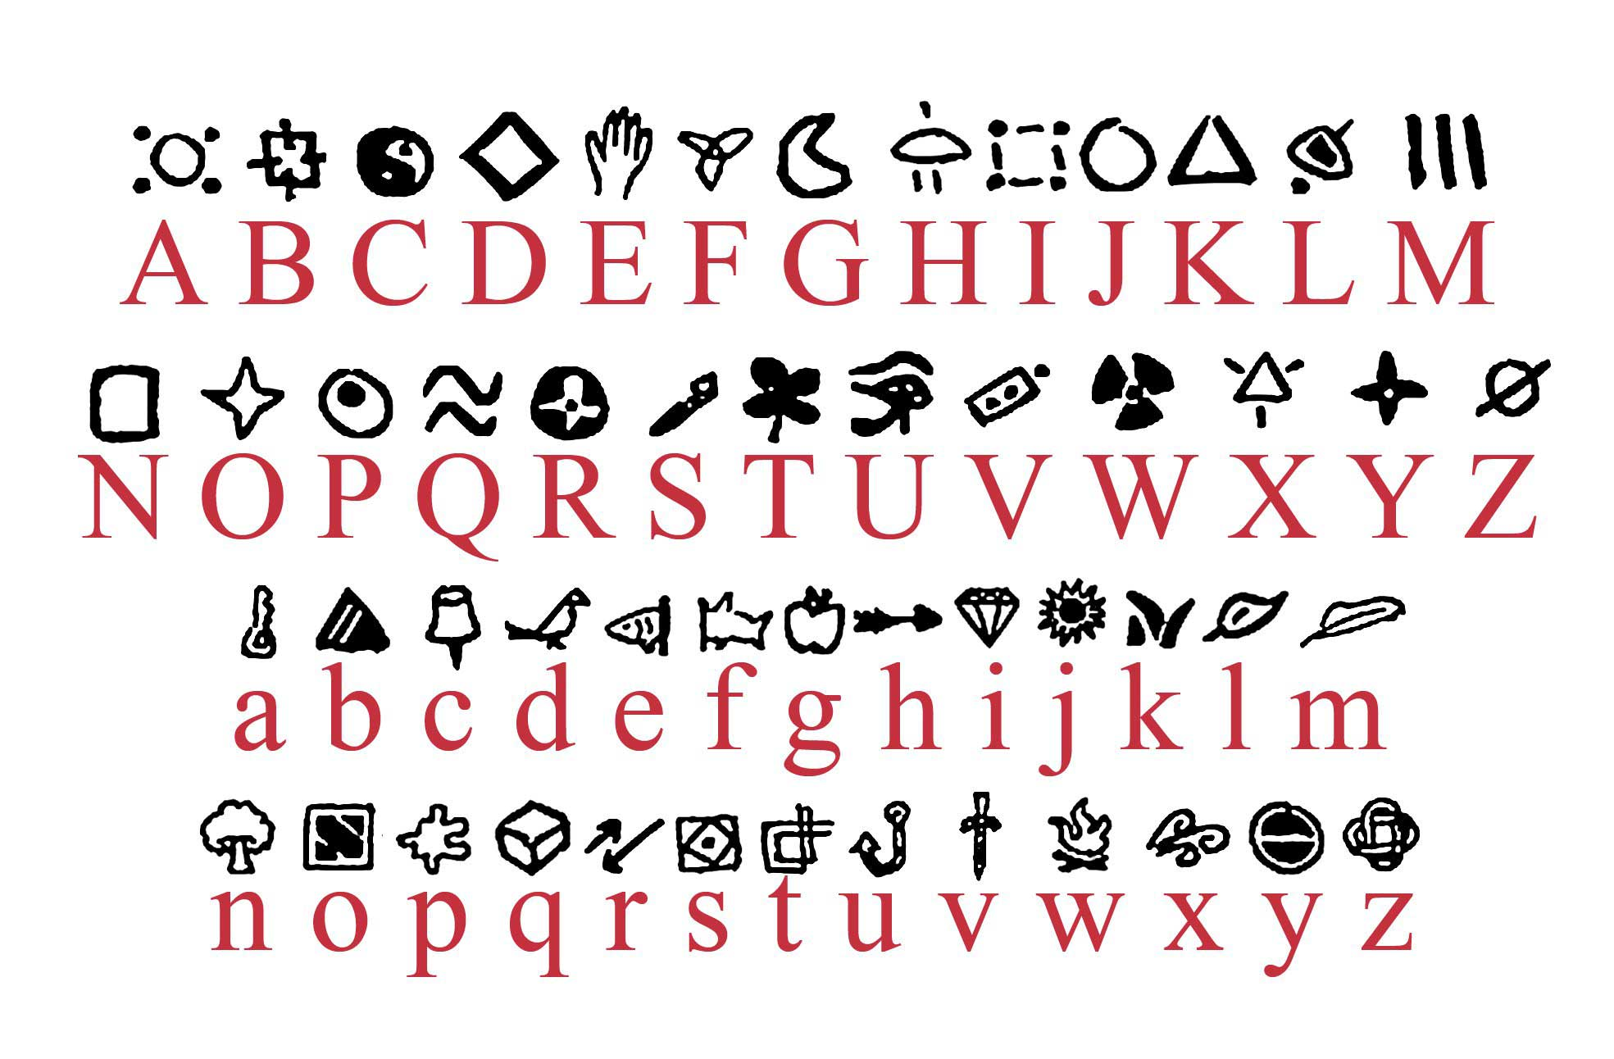
Symbols

Slide 9
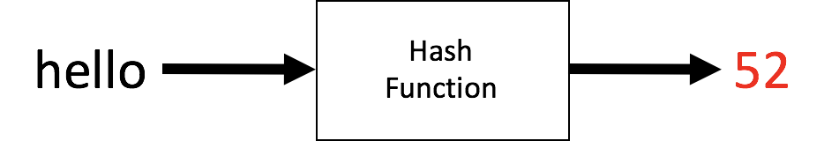
What’s Happening Here?

Slide 10
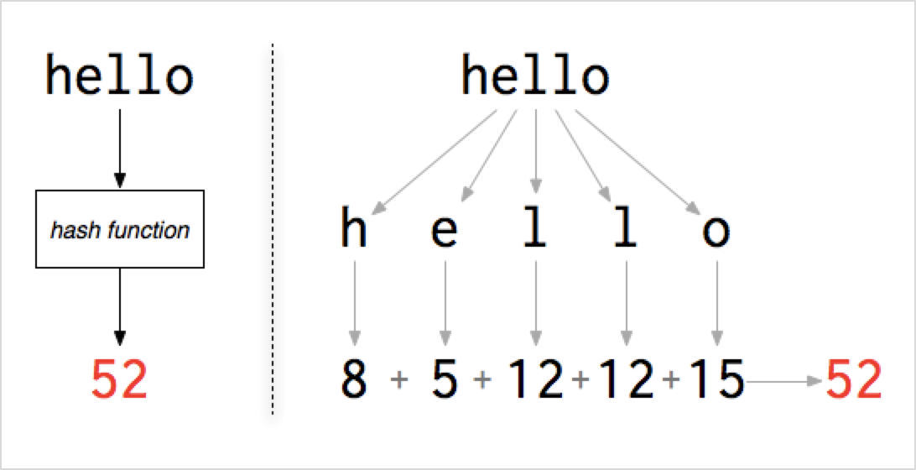

Slide 11

Write Your Own Cipher!

Slide 12
Let’s Crack Some Ciphers!
13-5-4-1-12-12-1
medalla
natry
angel
claelmo
camello

Slide 13


Classical Computing

Slide 14

Quantum Computing
Notes:
Exist in 2 states at once! A mystery… no one really knows how.

Slide 15
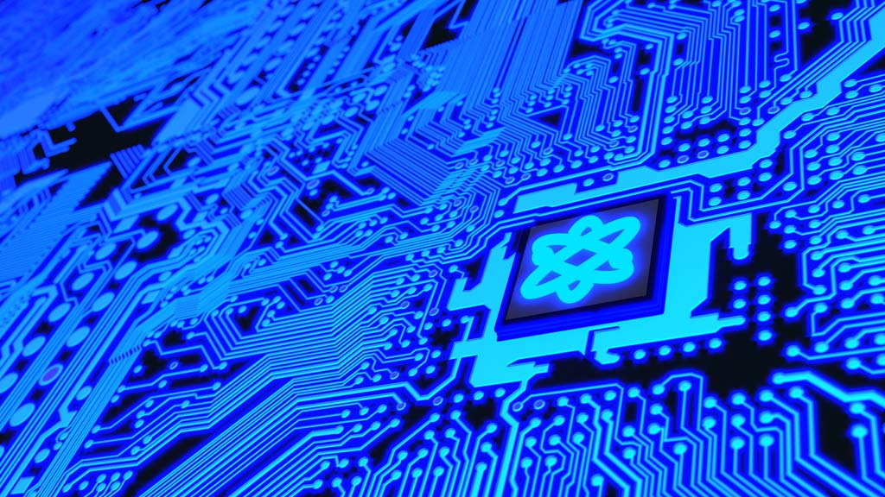
Quantum computing can break classical ciphers!
Notes:
Quantum computing has the potential to break a lot of our known encryption algorithms
Talk about how we have the algorithms… just not the computer that can run them… so it’s a race between countries! (This stuff IS ENORMOUSLY fascinating at a high level… I think they’ll appreciate it, even without any mathematical details. Maybe it’ll spark an interest in one of them.)

Slide 16
Searching - Round 1
15 volunteers please!

Slide 17
Searching - Round 2
15 volunteers please!

Slide 18


Searching
How does a computer find things in a long list?
Notes:
Do the exercise with the cards and the sorting

Slide 19
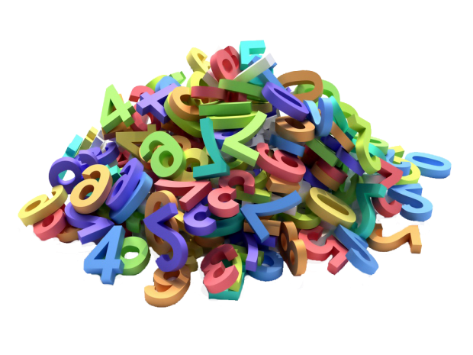
I am thinking of a number between 1 and 15. You can guess as many times as you want, and I will tell you if my number is “higher” or “lower” than my number. What is the minimum number of guesses you would need to be sure you can find my number?

Slide 20

How can a computer help us make decisions?

Slide 21
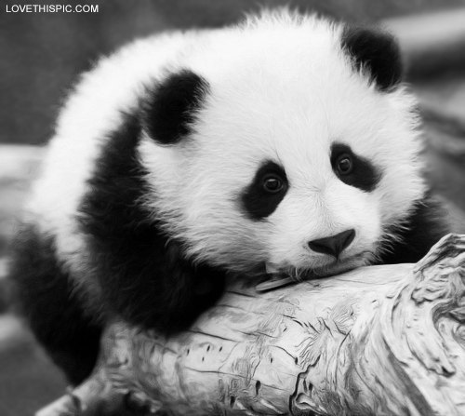
Is the number less than, equal to, or greater than...
5
8?
less
bigger
4
12
less
bigger
less
bigger
2
6
10
14
less
bigger
less
bigger
less
bigger
less
bigger
1
3
5
7
9
11
13
15
Notes:
Does anyone know what this is called?

Slide 22
Is the number less than, equal to, or greater than...
5
8
4?
12
less
bigger
2
6
10
14
less
bigger
less
bigger
1
3
5
7
9
11
13
15
Notes:
Does anyone know what this is called?

Slide 23
Is the number less than, equal to, or greater than...
5
8
4
12
2
6?
10
14
less
bigger
1
3
5
7
9
11
13
15
Notes:
Does anyone know what this is called?

Slide 24
Is the number less than, equal to, or greater than...
5
8
4?
12
2
6
10
14
1
3
5
7
9
11
13
15
Notes:
Does anyone know what this is called?

Slide 25
Is the number less than, equal to, or greater than...
8
less
bigger
4
12
less
bigger
less
bigger
2
6
10
14
less
bigger
less
bigger
less
bigger
less
bigger
1
3
5
7
9
11
13
15
Notes:
Does anyone know what this is called?

Slide 26
MAXIMUM: 3 GUESSES
8
1
4
12
2
2
6
10
14
3
1
3
5
7
9
11
13
15
Notes:
Does anyone know what this is called?

Slide 27
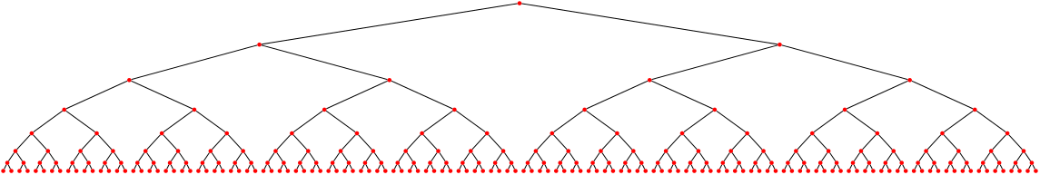
Why is binary search so powerful?

Slide 28
Make your own binary decision tree!
?
no
yes
?
?
no
yes
no
yes
A
B
C
D

Slide 29


Example: Activities for the Day
Is it raining?
no
yes
Is it warm?
Is it a holiday?
no
yes
no
yes
Drink hot cocoa
Have a picnic
Go shopping
Read a book

Slide 30
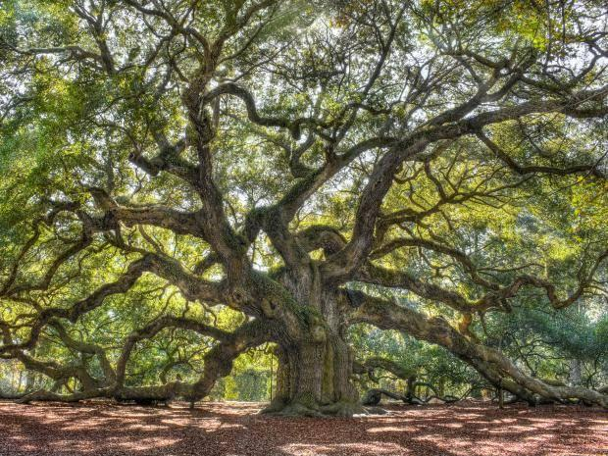
Make your own binary decision tree!

Slide 31
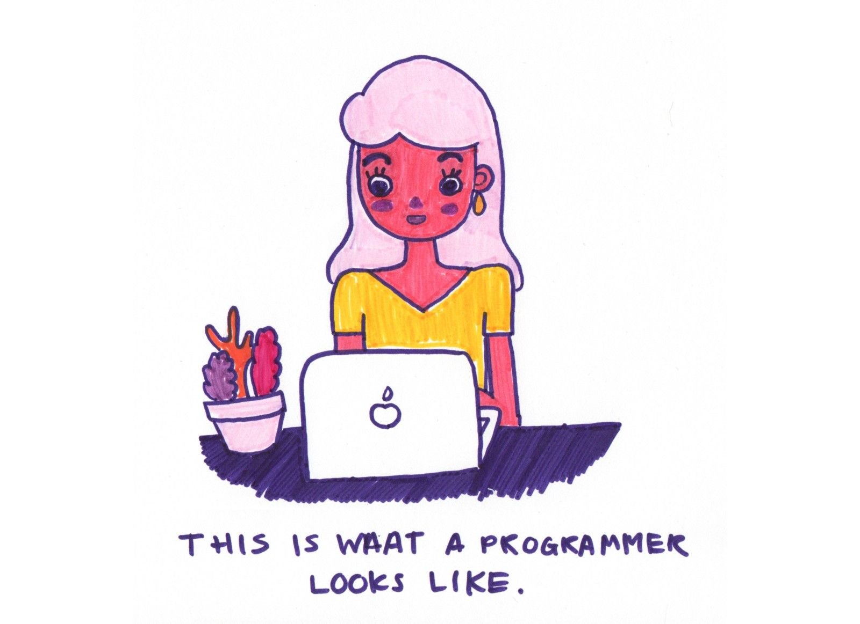
Coding Exercises

Slide 32
If-else Statements
if (condition 1)
do Thing 1
else if (condition 2)
do Thing 2
Is it raining?
no
yes
Have a picnic
Read a book

Slide 33
While Loops
while (condition)
do a thing
update condition

Slide 34
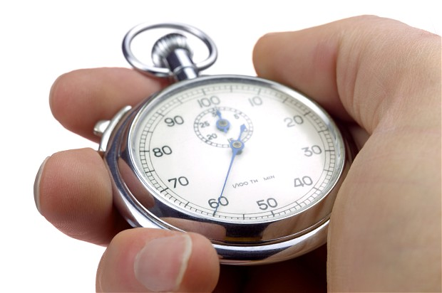
Timers
var counter = 0;
setInterval(function(){
counter++;
console.log(counter);
}, 500);

Slide 35
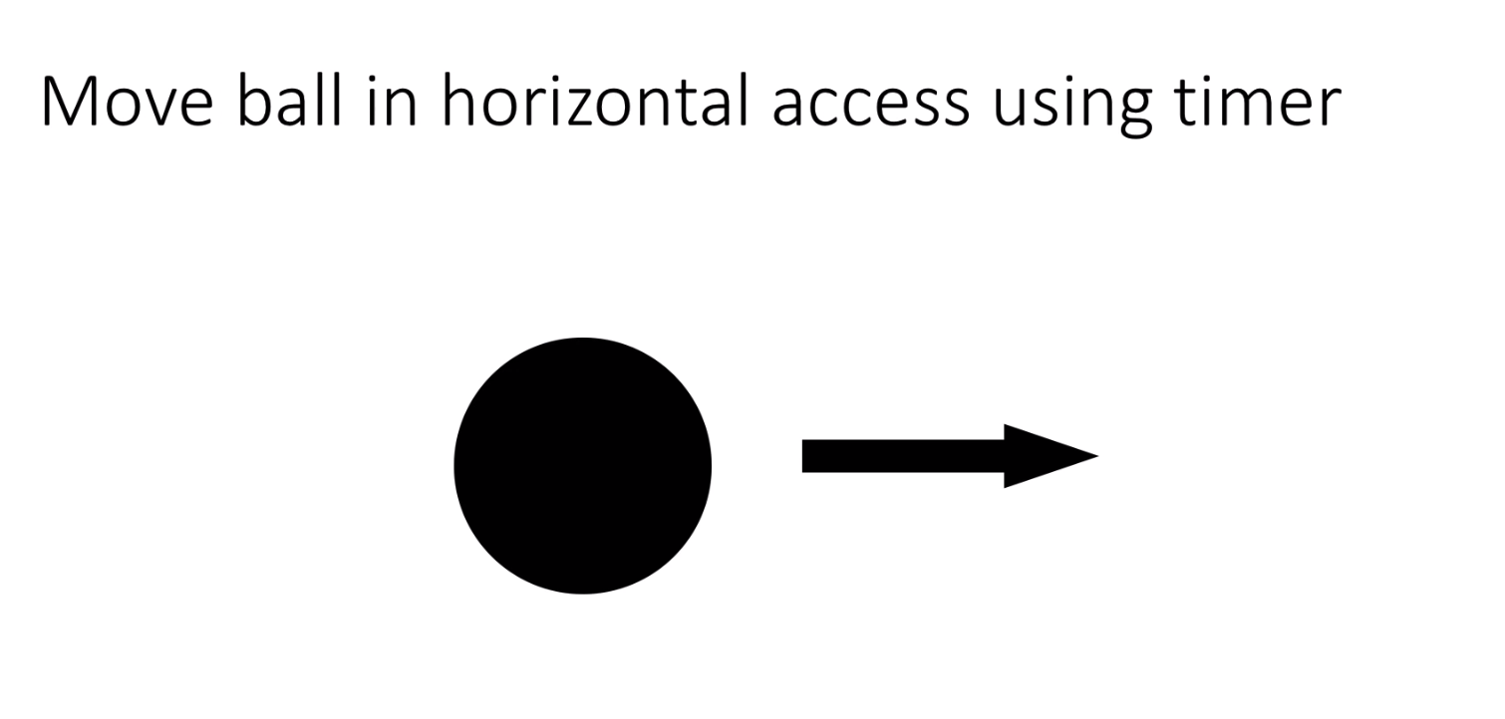

Slide 36
Hints
need document.getElementById(“ball”) to get the the reference to the ball
See what ball.style.left is
setInterval(function(){
},100);

Slide 37

Solution!
var velocity = 5;
var position = 0;
var ball = document.getElementById('ball');
setInterval(function(){
position = position + velocity;
ball.style.left = position + 'px';
},100);

Slide 38
Make the ball reverse direction and velocity at left / right edges (0px, 200px)

Slide 39
Previous Code - modify
// modify so it changes direction and goes back 0px, 200px
var velocity = 5;
var position = 0;
var ball = document.getElementById('ball');
setInterval(function(){
position = position + velocity;
ball.style.left = position + 'px';
},100);

Slide 40
Edge Detection
var velocity = 5;
var position = 0;
var ball = document.getElementById('ball');
setInterval(function(){
if(position > 200 || position < 0){
velocity = -1*velocity;
}
position = position + velocity;
ball.style.left = position + 'px';
},100);

Slide 41
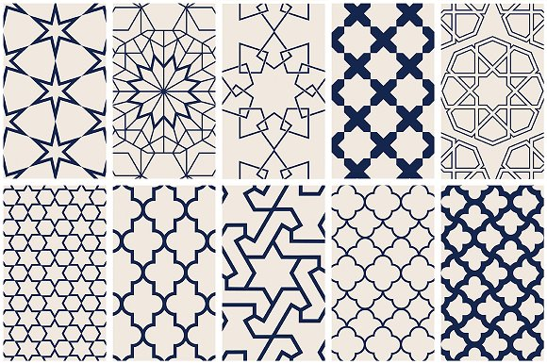
Milestone 2

